Slide 1

TSE CUSTOM INITIALIZR
GROUP 4:
Tunir Chaudhuri, Akash Ranjan, Goutham Suresh, Rahul, Sunny Kumar
Page 1

Slide 2
INTRODUCTION
The Custom Spring Initializr is a tailored version of the Spring Initializr, a web-based tool that simplifies and accelerates the bootstrapping of Spring-based projects. It offers a personalized development experience by allowing developers to define custom project templates, dependencies, and metadata.
While https://start.spring.io/ is an excellent start for your next Spring Boot project, sometimes it may be necessary to customize it to your own needs e.g., for the following reasons:
You may be required to provide a self-hosted instance of the Spring Initializr within your company e.g., due to network restrictions when downloading archives from the web.
You may want to tweak or brand the UI or even build your own UI from scratch.
You may want to provide your own project configurations and/or dependencies e.g., company internal Spring Boot starters that are not publicly available on the web.
Page 2

Slide 3
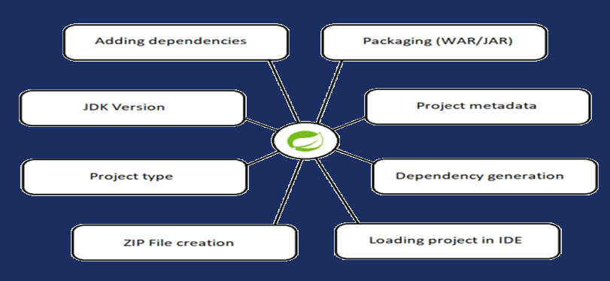
OBJECTIVES
The aim of our project is to simulate an instance of the Spring Initializr on localhost with added custom dependencies and other special features along with all the features in the user stories
Page 3

Slide 4
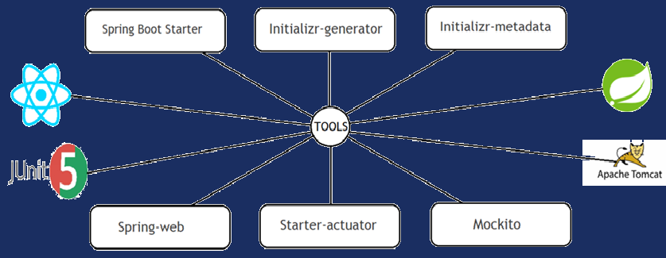
TOOLS
Page 4

Slide 5
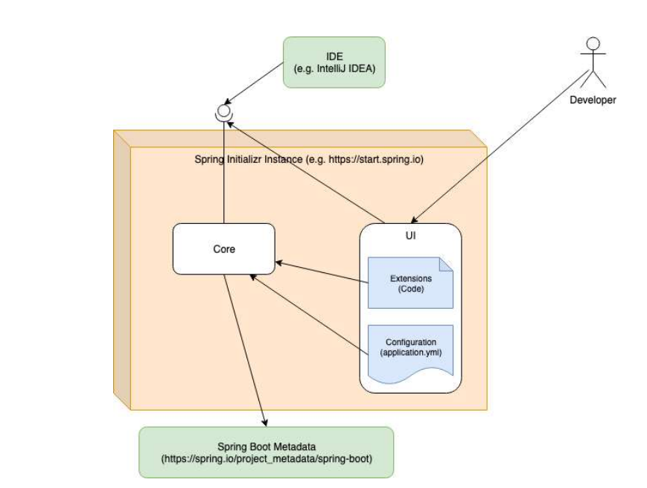
INITIALIZR WORKFLOW

Slide 6
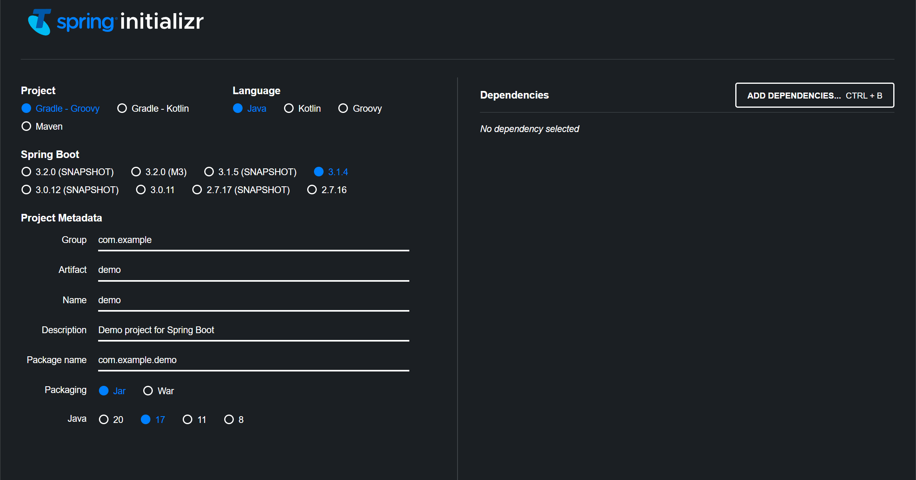
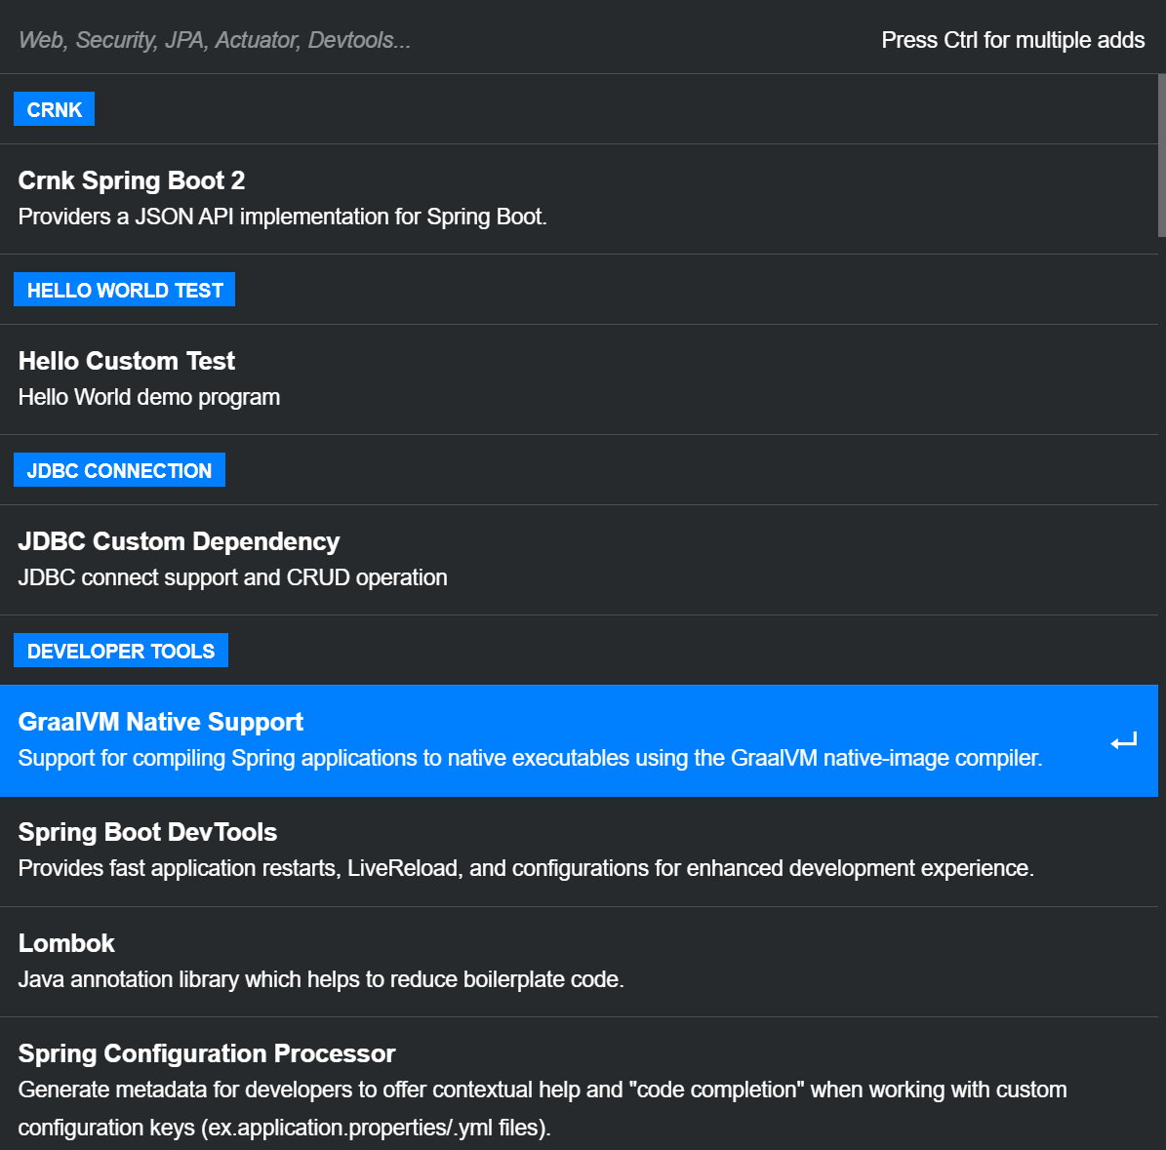

USER INTERFACE
Page 6

Slide 7
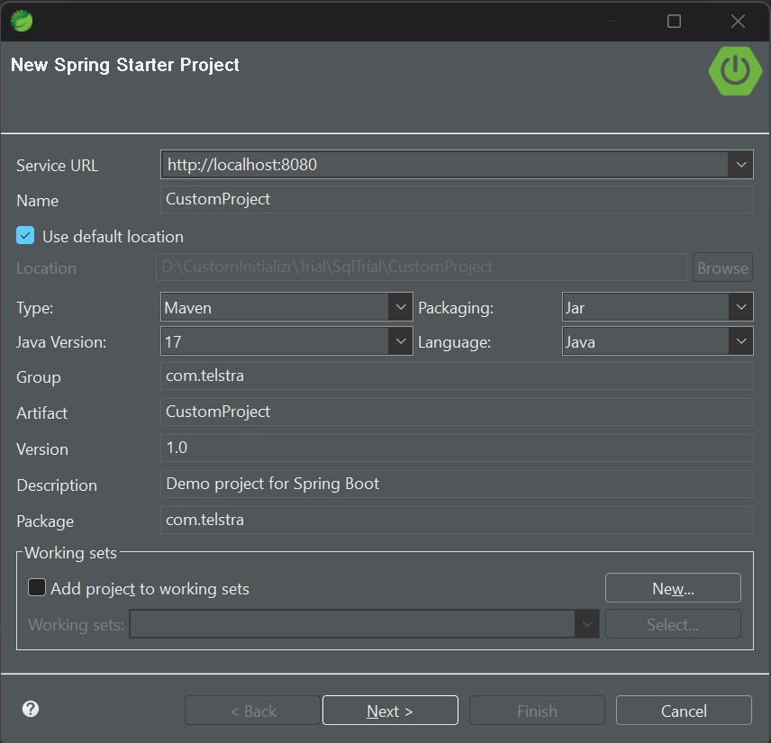
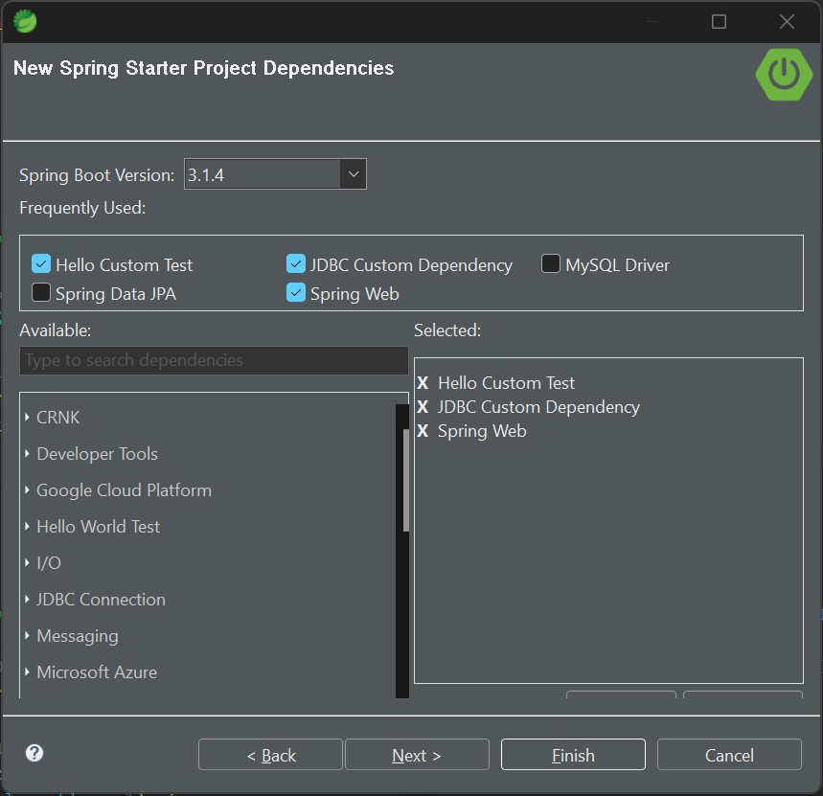
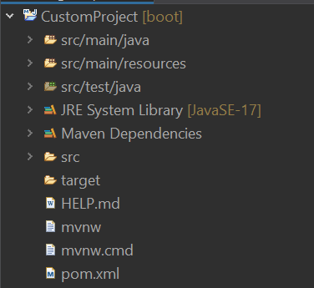
USER INTERFACE
Page 7

Slide 8
LIVE DEMONSTRATION

Slide 9
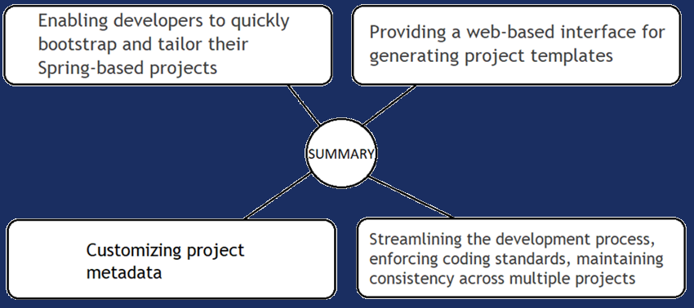
SUMMARY
Page 9

Slide 10
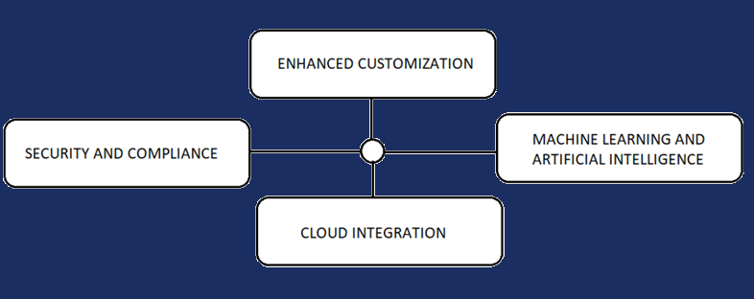

FUTURE WORK
Page 10

Slide 11





ABOUT US
Tunir Chaudhuri
ASE
Akash Ranjan
ASE
Goutham Suresh
ASE
Rahul
ASE
Sunny Kumar
ASE
Page 11

Slide 12
Thank You
Page 12

